Slide 1
Behavioral Health Integration: Health IT Considerations: Funding and Procurement
ONC SIM Resource Center Affinity Group Call
May 11, 2016
Terry Bequette, Consultant/Contractor, Office of Care Transformation, ONC
Thomas Novak, Medicaid Interoperability Lead, ONC and CMS

Slide 2
Conflicts of Interest
Terry Bequette terry.bequette@hhs.gov
Has no real or apparent conflicts of interest to report.
Tom Novak Thomas.Novak@hhs.gov
Has no real or apparent conflicts of interest to report.

Slide 3
Agenda
Behavioral Health Integration – Brief Overview
Behavioral Health Integration Framework Considerations
  Policy
  Technical
  Business Operations / Workflow
  Financial – Today’s Discussion
Funding Considerations
  Existing Funding streams: SIM; IAPD; SAMHSA
  New funding streams: SMD 16-003
    Architecture and Onboarding examples
Resources
Affinity Group Discussion
  State Round Robin – Thoughts / Ideas/ Concerns

Slide 4
Integration of Behavioral and Physical Health Services in Medicaid:
Key Points
Services for Physical Health (PH) and Behavioral Health (BH) (includes mental health (MH) and substance use disorders (SUD)) historically have been financed and delivered under separate systems. Health IT systems tend to be separate as well.
Large number of beneficiaries with BH diagnosis and substantial associated costs → state Medicaid programs are looking for ways to improve care and reduce expenses.
Integrating PH and BH shown to reduce fragmentation of services and promote care for adults with depression and anxiety disorders. Current evidence is limited for other instances. Data and information integration is needed.
There is no one-size-fits-all model for BH integration. Efforts can encompass clinical, financial, and administrative domains.
Health IT is essential to supporting this integration, including local systems, information exchange, data and analytics (measures, aggregation, reports), and state-based systems for Medicaid enrollment and administration.

Slide 5
Behavioral Health Integration Framework Considerations
Policy
  Programs and models
  Standards and certification as policy levers
  Privacy and data sharing
Technical
  Health IT infrastructure modules
  SAMHSA’s work in BH-related Health IT
  Health IT is essential to supporting this integration, including local systems, information exchange, data and analytics (measures, aggregation, reports), and state-based systems for Medicaid enrollment and administration.
Business Operations: Workflow
  Global: administration, billing, TA, Quality measurement and reporting
  Local: clinical, administration, billing, data access and sharing
Finance
  SPAs and Waivers; SIM; Medicaid/HITECH APDs
  SMD 16-003 expansion of HIE-related funding to other providers
Policy
Technical
Business Ops
Finance

Slide 6
Health IT Considerations: the Health IT Stack of Infrastructure Modules
  Reporting Services
Some combination of these modules needed for all Health IT use cases
Modules that take prominence in BH integration:
  Policy/Legal
  Consent management
  ID management
  Exchange services
  Notification services
None are excluded in the BH integration use case
  Analytics Services
  Consumer Tools
  Notification Services
  Provider Tools
  Exchange Services
  Patient Attribution
  Data Extraction
  Data Transformation
  Data Aggregation
  Data Quality & Provenance
  Identity Management
  Provider Directories
  Security Mechanisms
  Consent Management
  Governance
  Policy/Legal
  Financing
  Business Operations

Slide 7
Funding Considerations
Program and implementation level considerations
SAMHSA-HRSA grant opportunities
State HIT funding considerations
  SIM Grant Federal Opportunity Announcement (FOA) Information
  Funding and the Shared Services Stack of Infrastructure Functions
  State Medicaid Directors Letters: 10-016 and 11-004
  State Medicaid Directors Letter: 16-003
    Architecture and Onboarding examples
  Medicaid and HITECH Funding Possibilities and Implications

Slide 8
Financial Considerations
Program Level – State Plan Amendment; 1115 Waiver
  The state Medicaid agency, probably in collaboration with other agencies in and out of state government, determines a To-Be model for BH and PH integration. SPAs and Waivers are the mechanisms for negotiating changes to the Medicaid program.
  MMC Proposed Rule – states could make available incentive payments for the use of technology that supports interoperable HIE by network providers that were not eligible for EHR incentive payments under the HITECH Act.
  Also, an exception for the Institutions for Mental Diseases (IMD) restriction
  Expanded support for Medicaid Health Information Exchanges – SMD #16 -003
  SIM Grant for practice transformation TA; EHR adoption TA
  Medicaid Innovation Accelerator Program (IAP)
Implementation Level
  Care delivery end points – consider a combination of state-acquired funding and practice-level funding (HRSA grants; SAMHSA grants; Value-based payment incentives)
  Medicaid Eligible Professionals should not lose their last chance for EHR incentive payments; they are likely to be the ones doing behavioral health integration.
Notes:
Institutions for Mental Diseases (IMDs)
Although federal funding is generally not available for services furnished to people who reside in IMDs, the final rule, as it did in proposed form, draws a crucial exception, permitting states to make monthly capitation payments to plans for adults ages 21-64 who receive inpatient treatment in an IMD, so long as the IMD meets provider participation standards and the stay is no longer than 15 days during the capitation period. This provision, a marked departure from prior policy, represents a crucial recognition by CMS of the severe shortage of short-stay residential treatment services for beneficiaries, while at the same time guarding against lengthy stays that discourage treatment in the most integrated setting.

Slide 9
SAMHSA-HRSA Center for Integrated Health Solutions
Grant Opportunities
  Grant opportunities that foster the integration of primary and behavioral healthcare become available on a regular basis from SAMHSA, HRSA, and other federal agencies, in addition to foundations and others invested in improving healthcare in this country.
Current Grant Opportunities (as examples):
  MEDICATION ASSISTED TREATMENT. SAMHSA is providing funds for state agencies to expand or enhance access to medication assisted treatment services for individuals with opioid use disorder. Learn more and apply by May 31.
  PEER NETWORKS
  SAMHSA, Center for Substance Abuse Treatment (CSAT) and Center for Mental Health Services (CMHS) are accepting applications to expand the peer workforce, build infrastructure, and enhance capacity among currently funded SAMHSA Recovery Community Services Program - Statewide Networks (RCSP-SNs), currently or formerly funded Statewide Consumer Networks (SCNs), and currently or formerly funded Statewide Family Networks (SFNs). Learn more and apply by June 21

Slide 10
SIM Grant FOA Information
SIM Grant funding is possible for Health IT and HIE
  Can include infrastructure for collecting and managing model testing initiatives, including associated HIE, Provider Directory, Master Person Index, data management and analytics, even an All Payer Claims Database (APCD)
SIM funding may not supplant existing federal or state funding
  Coordinate with projects that may already by funded for needed infrastructure (SMHP, EHRIP, IAPD considerations)

Slide 11
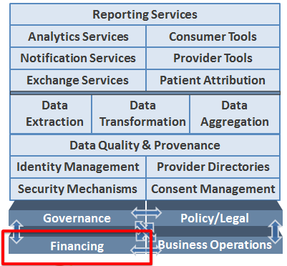
Funding and the Shared Services Stack
Functions or services are translated into systems defined by requirements; system solutions are procured to provide the needed functions/services
Technical solutions to support the HIE implied by the stack with data sources and users can also be funded and procured
Ongoing maintenance funding is impacted by funding decisions for implementation

Slide 12
Health IT Funding Through Medicaid: Options
MMIS-MITA:
  90/10 Medicaid funding for Design, Development and Implementation of technology supporting the Medicaid program
  75/25 Medicaid funding for ongoing operations/maintenance
90/10 HITECH Act:
  HITECH-HIT to support the administration of the EHR Incentive Program and to support “meaningful use”
  HITECH-HIE to support Medicaid fair share along with funding from external partners
  HITECH-MMIS related for the support of the administration of the Medicaid Program
50/50 Medicaid Administrative:

Slide 13
HITECH HIE Funding Parameters
90/10 funding is available for HIE activities provided that:
Funds are used for time-limited Design Development and Implementation Activities
States leverage efficiencies with other Federal HIE funding
HIE costs are divided equitably across other payers based on the “fair share” principle and are appropriately allocated.
Resources for implementation:
SMD* Letter-Use of Administrative Funds to Support HIE (11-004)
Frequently Asked Questions (FAQs) (Superseded by SMD 16-003)
SMD Letter-Federal Funding for Medicaid HIT** Activities (10-016)

Slide 14

14

Slide 15
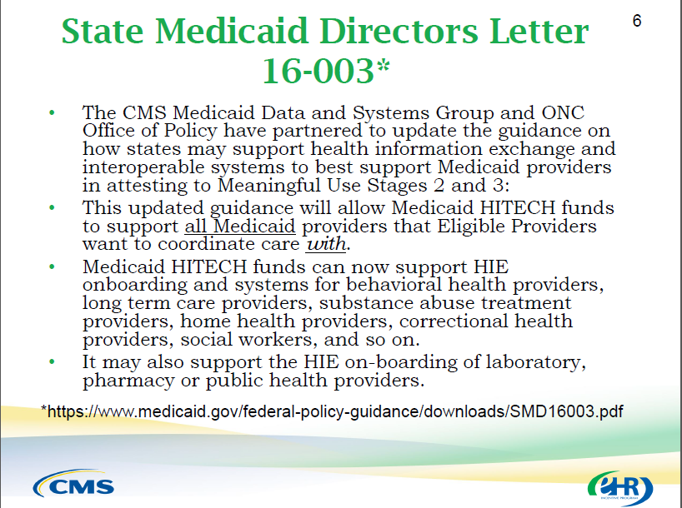
15

Slide 16
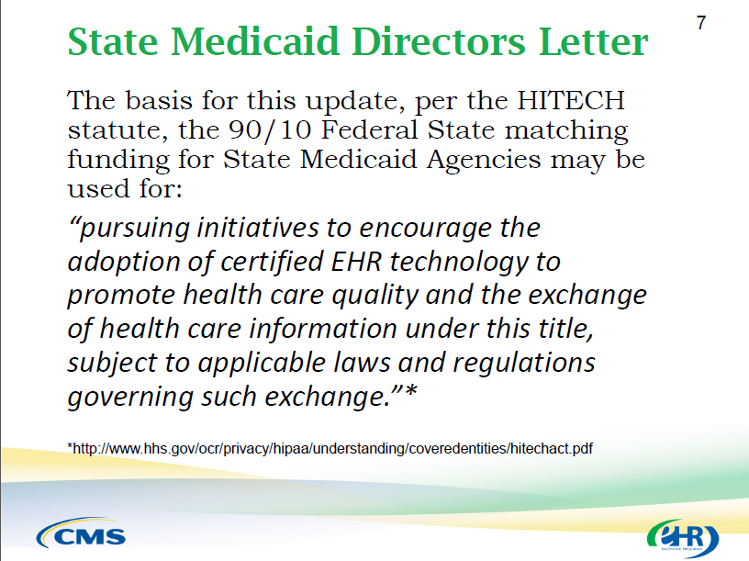
16

Slide 17
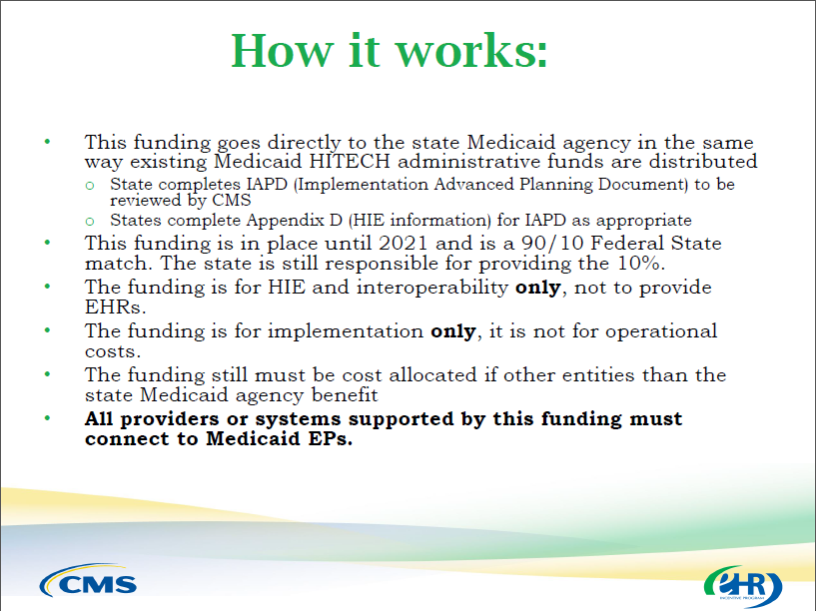
17

Slide 18
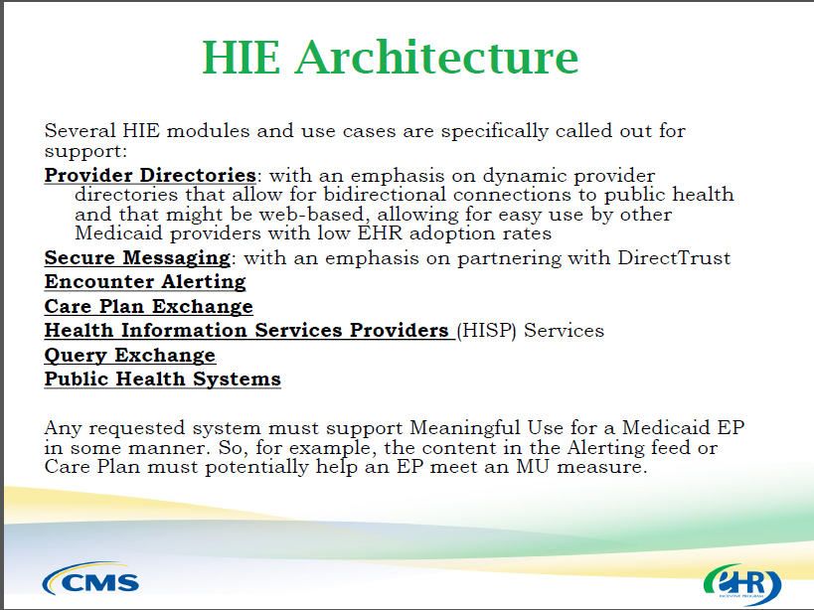
18

Slide 19
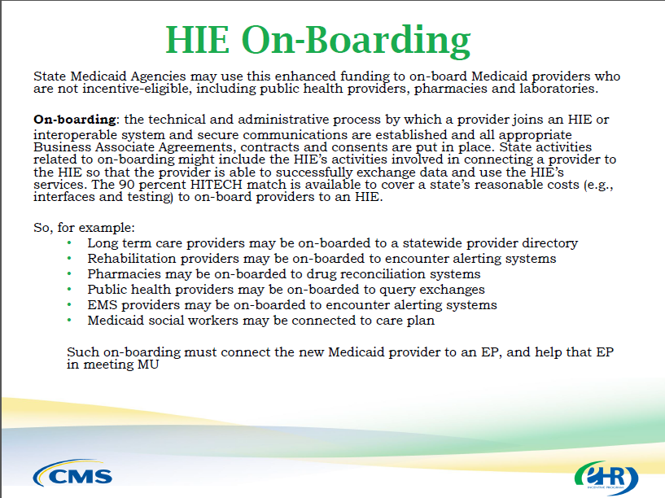
19

Slide 20
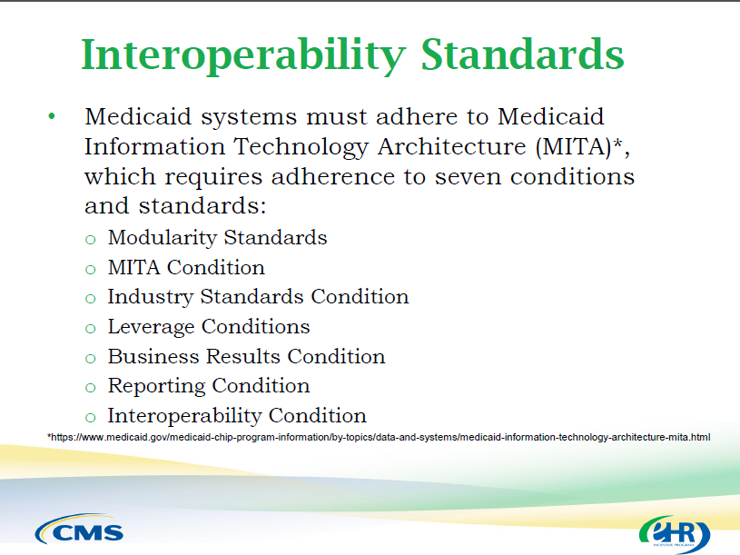
20

Slide 21
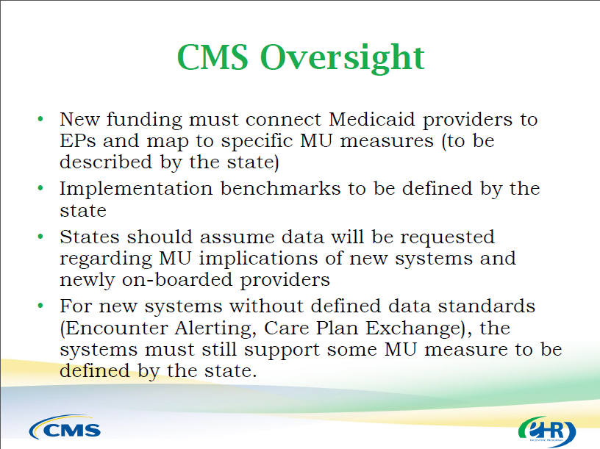
21

Slide 22
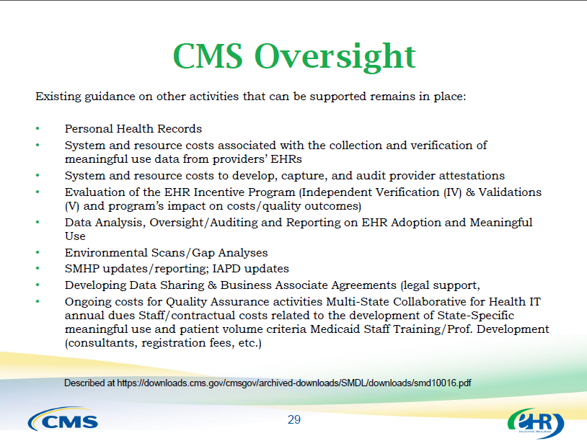
22

Slide 23
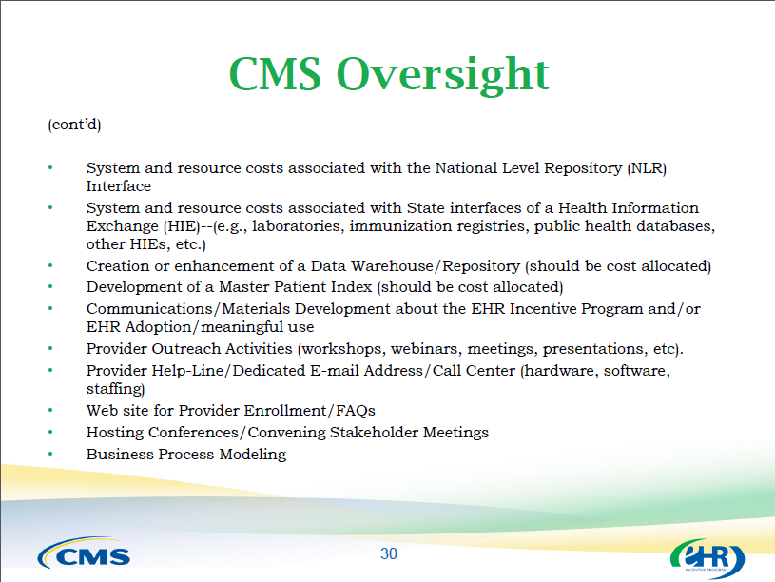
23

Slide 24
SMD 16-003 Examples
Architecture
Registries (SA, trauma, vital records/birth, clinical data, dental)
  Public Health Interfaces; BH
Provider Directory
  Web-based for providers without EHRs
Encounter Alerting
Query Exchange
Shared care plans
Corrections interfaces
  Between environments of community and incarceration
HIE entity qualifying baselines
  PD, PH, Direct, Trust, no blocking, interoperability with disparate systems, CEHRT, onboard to quality measures
On-Boarding
Medicaid Pharmacies
BH and LTC providers
  As listed by EHs
Leverage previous IAPD methodology for other provider types
  Referral partners of attesting providers
Connect all providers to Direct
Community Health Teams
Onboard Medicaid providers to non-state HIE entities, if baseline qualified

Slide 25
HITECH Processes: Required Federal Funding Documents
State Medicaid HIT Plan: SMHP – at least annually – prior or simultaneous to IAPDU
Implementation Advanced Planning Document: I-APD and I-APDU (Appendix A and D)
Pre-approval of Contracts

Slide 26
Procurement Considerations
Health IT Project Plan Phases:
  Planning and Design
  Pre-Procurement
  Procurement
  Implementation
State Project Management Oversight Considerations
Quality Assurance Considerations (QA)
Systems Integrator Considerations
Independent Validation and Verification (IV&V) Considerations

Slide 27
Funding Gap Issue – Building the Case for Value Investments
Funding opportunities as presented may not be sufficient
  Fair share might be generous, but funding the match can be a hurdle
It is worthwhile to develop a value proposition and a business case
  This is challenging work from the perspective of non-eligible providers
Identify all benefits and savings for the healthcare delivery/payer system as a whole, not just specific to the non-eligible provider
If system benefits can be demonstrated to justify the investment, then the business case helps to support an IAPD
  But might also support a more creative approach if a community, region, or state can take the long view and gather financial support from all stakeholders who stand to benefit

Slide 28
Discussion Questions and Topics: Funding
COORDINATION OF FUNDING STREAMS: Are you coordinating your SIM funding for Health IT and HIE with HITECH/Medicaid funding through the SMHP and IAPD processes?
FAIR SHARE: Is “fair-share” funding for HIE-related projects being pursued?
  How are you determining a fair-share allocation for Medicaid?
  Who are the other payers? Are they participating?
TIMELINES AND ALIGNMENT: How does your funding timeline align with your procurement timeline? And how do these timelines align with your SIM Grant timeline?

Slide 29
Discussion Questions and Topics: Procurement
MARKET INFORMATION: Are you doing any market analysis – vendor scans or RFIs?
STATE IT OVERSIGHT: Does your state have existing governance for the oversight of IT (including Health IT) projects and procurement?
QUALITY ASSURANCE: Are you planning to use a QA vendor for your Health IT projects?
INDEPENDENT VERIFICATION AND VALIDATION: Are you planning to use an IV&V vendor for your Health IT projects?
SYSTEMS INTEGRATOR: Are you planning to use a Systems Integrator to manage the implementation?

Slide 30

Questions and Discussion

Slide 31
Next Steps and Adjourn
Notes from this call will be distributed
2nd Affinity Group call on privacy and security related to Behavioral Health Integration will be scheduled

